Slide 1
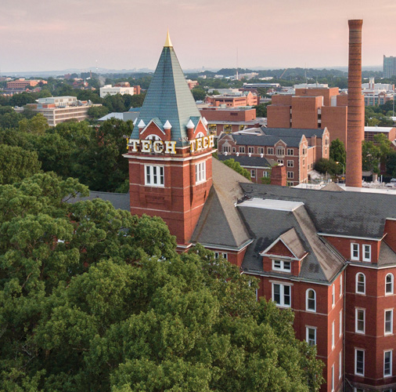

Electric Vehicle
Division C
Georgia Tech Event Workshop Series 2024-25

Slide 2
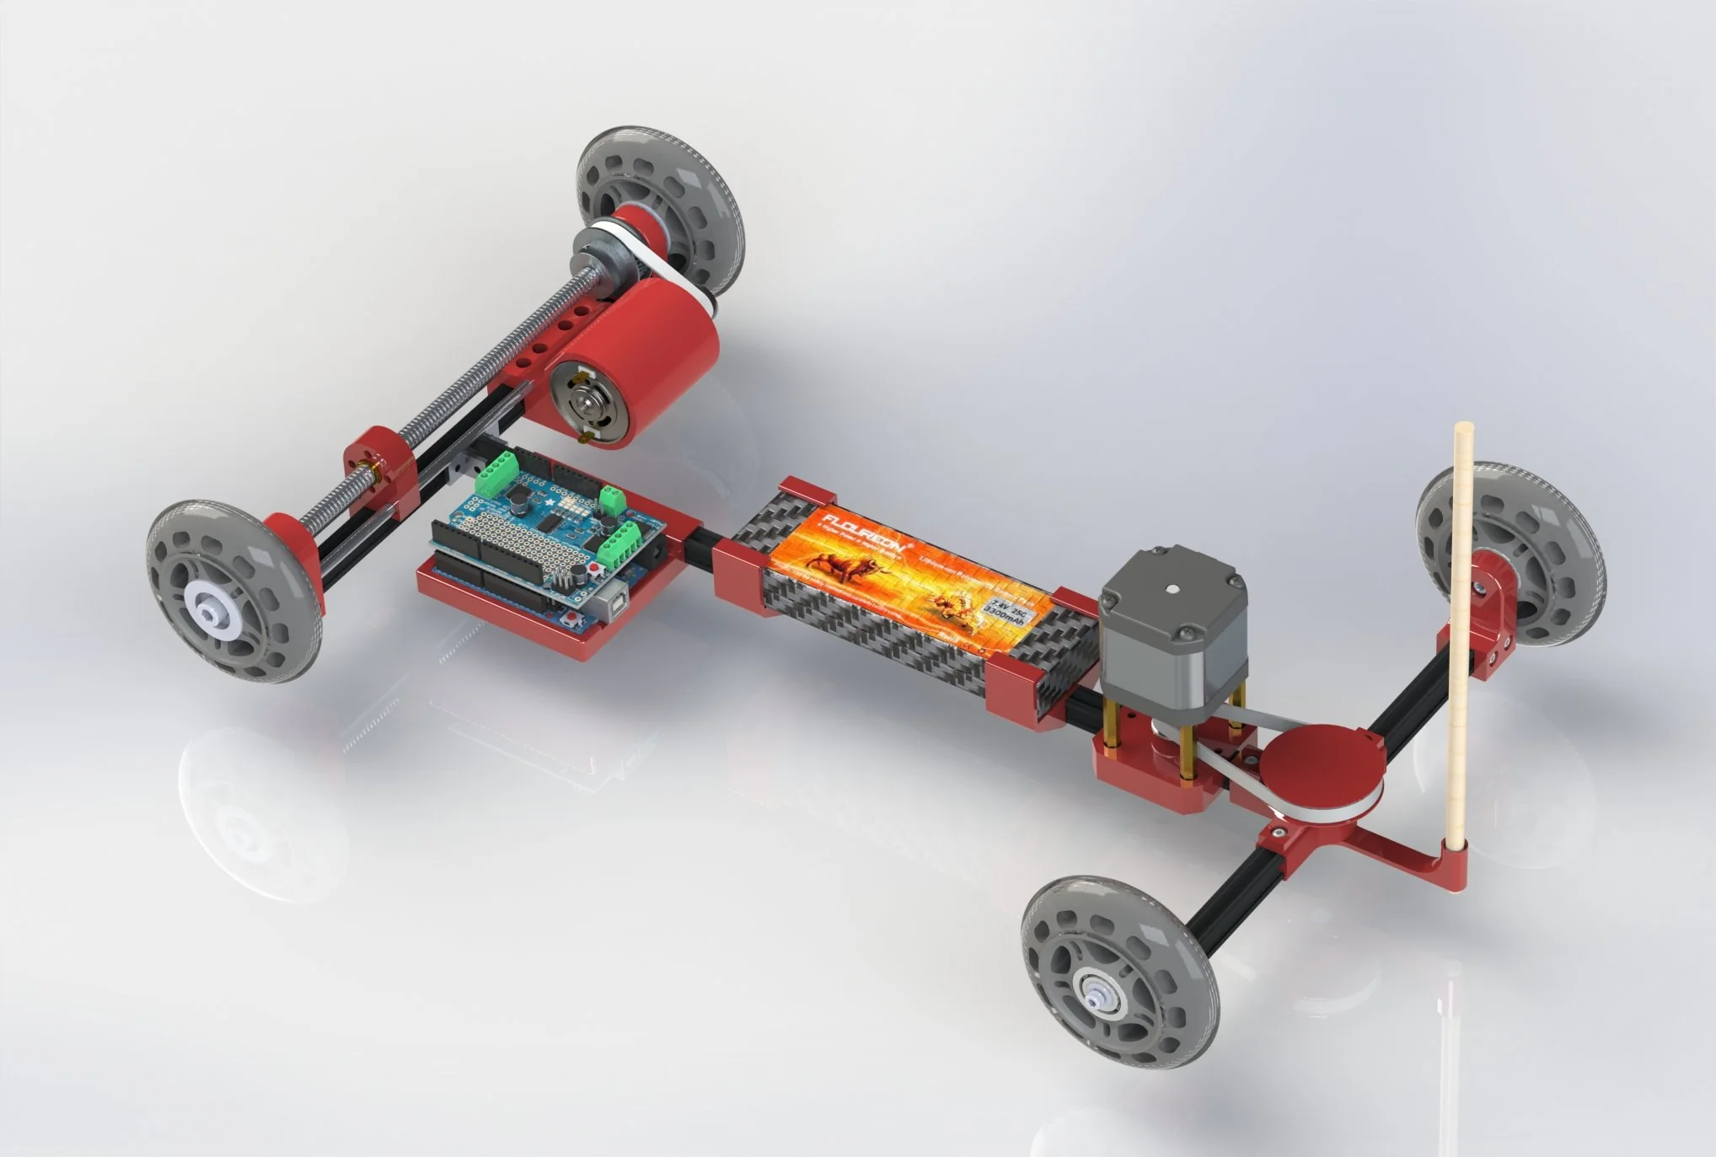
01
RULES SHEET
02
DIFFICULT TOPICS
[Event-Related Image]
03
COMMON QUESTIONS
04
TIPS FROM A VETERAN
05
OTHER FREE RESOURCES
Notes:
For Builds: Replace difficult topics with physical principles involved in the build and replace common questions with common designs

Slide 3
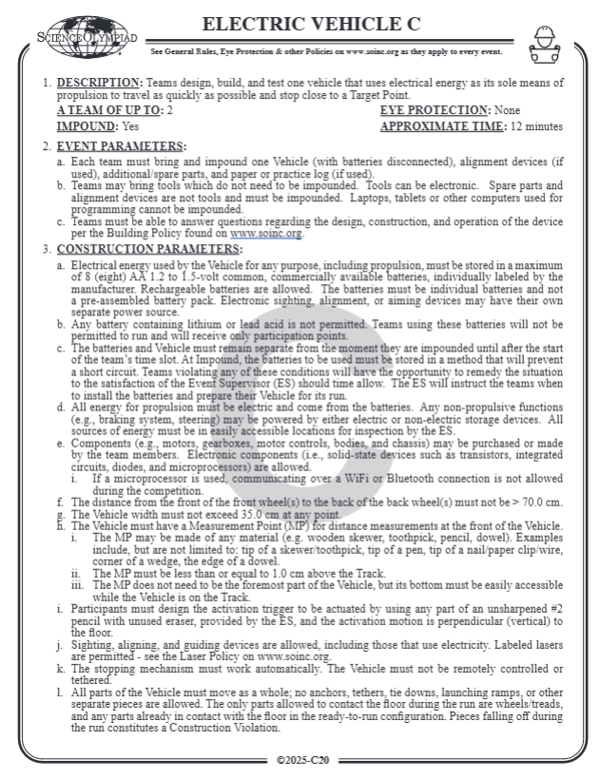
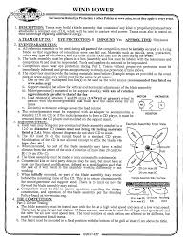
The Rules Sheet
Build an electric vehicle that autonomously goes from the start point to the target point as fast as possible
The target point will be located between 7-10m from the start point.
Scoring is as follows:
Total Score = Distance Score + Time Score + Run Penalties
Distance Score → 2.0pts/cm x distance(cm)
Time Score → run-time(s)
Run Penalties
Notes:
Highlight key points from the rules sheet: DESIGN LOGS that basically grant free points, most tested-on topics, point distribution so that competitors know what to prioritize, allowed notes and equipment, etc.

Slide 4

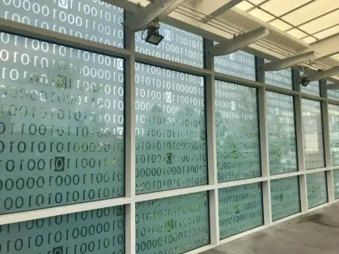
DIFFICULT TOPICS
Notes:
This section should focus on topics that are more math-based (harder to self-teach), concepts that come only usually up in college level courses, or concepts that you struggled with when you competed in this event

Slide 5
Topic 1: Movement
Electronics
Controller
Arduino, Lego Mindstorms, Raspberry Pi
Motor
Lego EV3, TT Motor
Distance Measurement
Wheel Rotations
Motor Time On
Detect Target Point

Slide 6
Topic 2: Wheel Rotations
One rotation of the wheel makes the car travel the circumference of the wheel
d = (ω) x (2π) x (r)
d → Distance Traveled
ω → Wheel Rotations
R → Wheel Radius
π → Pi
ω = (d) / (2π x r)

Slide 7
Tips from a Veteran
Slippery Tires will result in a shorter distance travelled
Use rubber wheels or wrap rubber bands around plastic wheels
Heavier vehicle can also help
For time to distance, old batteries will result in a shorter travel distance
Use rechargeable batteries at full charge for testing and the competition
Have an easy to access measurement point
Alignment is very important, make sure you have a calibration tool
Notes:
Use this section to talk about any strategies you used to navigate the event when you competed. For example, how did you manage your time, how did you organize your notes, how did you split topics up between you and your partner, etc.?

Slide 8
Additional Resources
Resource 1
Resource 2
SUBWAY STATIONS
Resource 3
Resource 4
Yes, Saturn is the ringed one. This planet is a gas giant, and it’s composed mostly of hydrogen and helium
Notes:
Here, you can link or mention any online or book resources that helped you in this event when you were a competitor. Try to avoid general resources like scioly wiki, because they probably already are familiar with it.

Slide 9
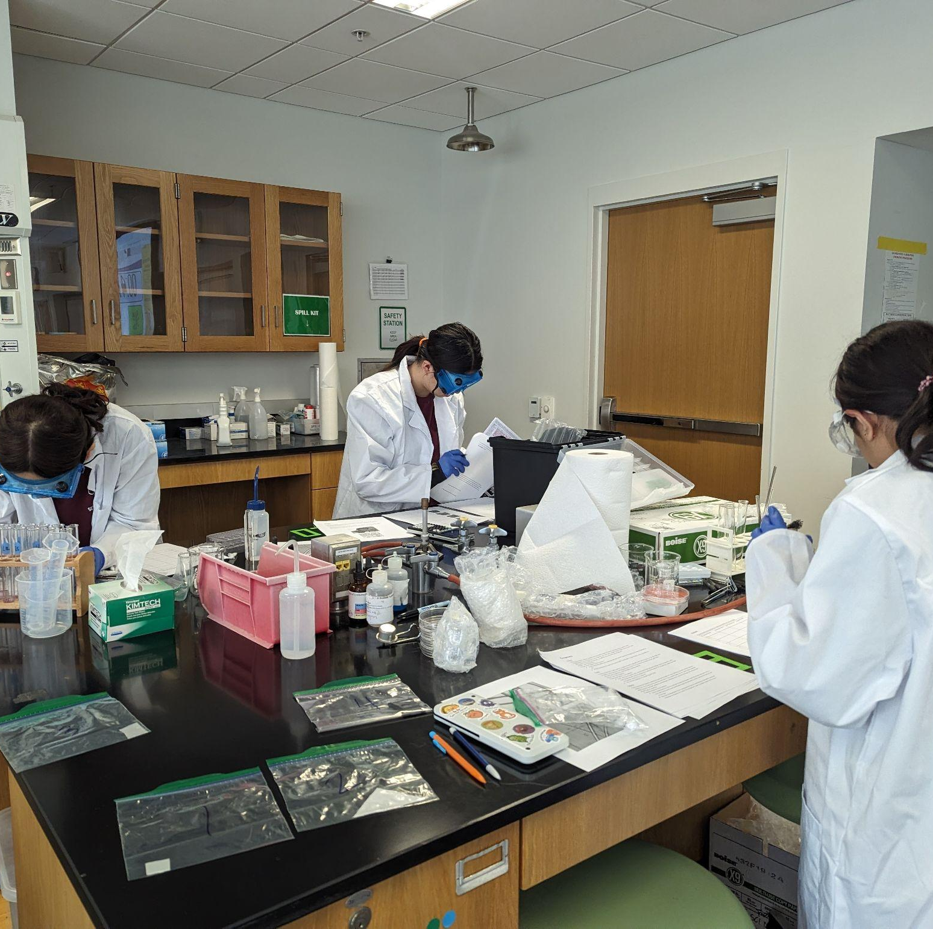
THANKS!
Notes:
(replace picture with a picture from one of our tournaments)

